Slide 1
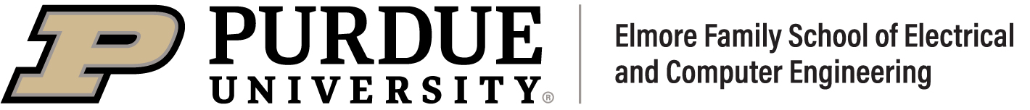
Research Presentation
Thermal Hall Effect
Presented By: Saumik Dey Shovan
Instructor: Peide (Peter) Ye

Slide 2
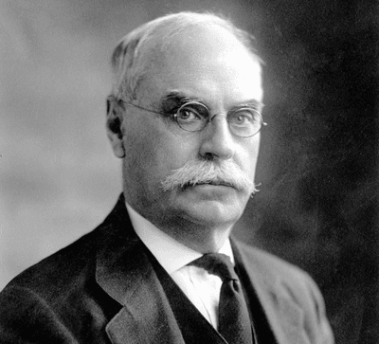
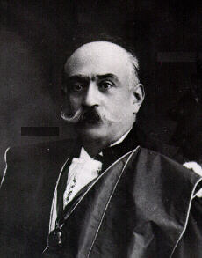
History of Thermal Hall Effect
Edwin Hall Hall Effect (1879)
Augusto Righi
Sylvestre Leduc
Thermal Hall Effect (1887)

Slide 3
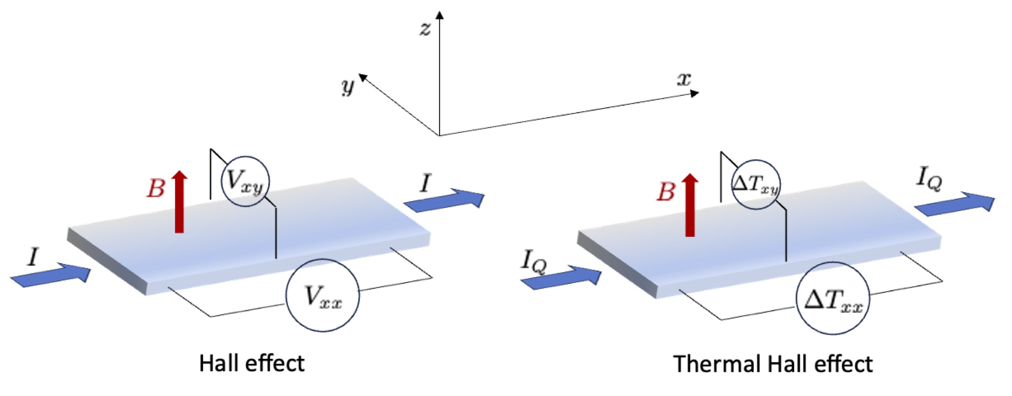
Hall Effect and Thermal Hall Effect
Hall effect
Lorentz Force Deflection
Surface Charge Accumulation
The Hall Field
Thermal Hall effect
Heat can bend sideways under a magnetic field
In metals, electrons carry heat and bend easily.
In insulators, heat is carried by phonons or magnons.
Quantum effects like the Berry phase can make it curve,
Cause is not always obvious.

Slide 4
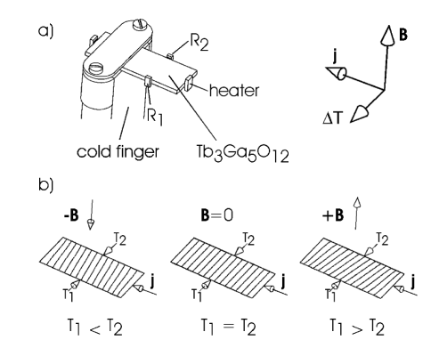
Microscopic Mechanisms (Phonon Hall Effect)
Magnetic fields induce a transverse temperature gradient via the Phonon Hall Effect
This setup demonstrates the effect in Terbium Gallium Garnet
Charge-neutral phonons exhibit spin-orbit coupling in certain materials
Skew scattering causes phonons to deflect sideways during heat transport
C. Strohm, Phys. Rev. Lett. 95, 155901 (2005)

Slide 5
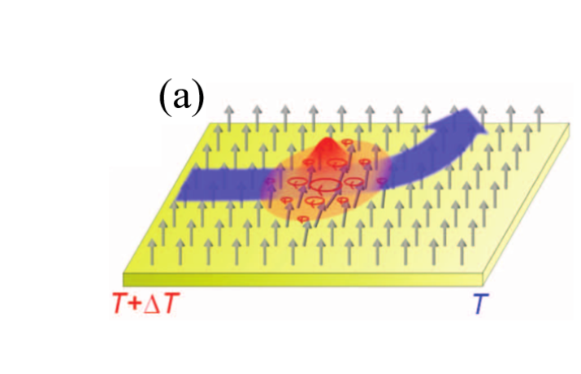
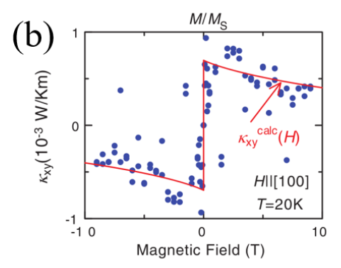
Magnon Thermal Hall Effect
Heat is carried by magnetic waves (Magnons)
Skyrmion acts like a tiny magnetic whirlpool
Magnons get a sideways push while passing through it
This comes from a complex internal magnetic force
Unlike phonons, behavior is nonlinear
Exhibits a sharp, sudden change in response
H. Takeda et al., Nat. Commun. 15, 566 (2024).

Slide 6
Impact of Thermal Hall Effect Research
Understanding Quantum Heat Transport Mechanisms
Studying Topological Materials
Enabling Directional Heat Control
Thermal Management in Nanoelectronics

Slide 7
Thanks

